Slide 1
Week 5
Blending, Fog

Slide 2



Slide 3
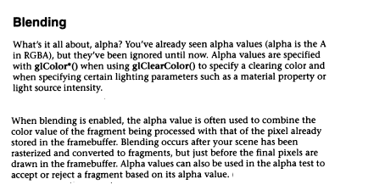

Slide 4
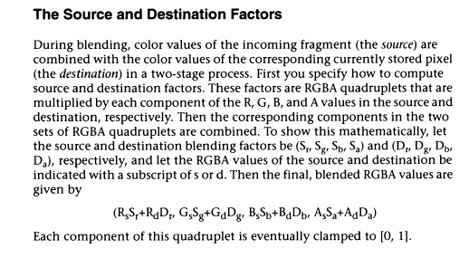
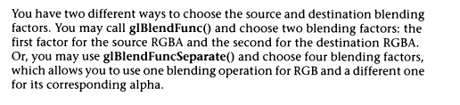

Slide 5
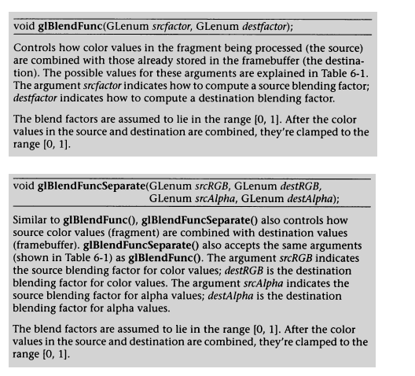

Slide 6
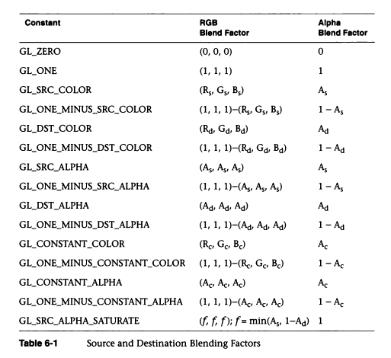

Slide 7
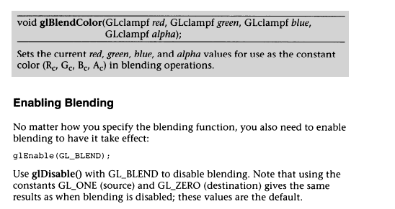

Slide 8
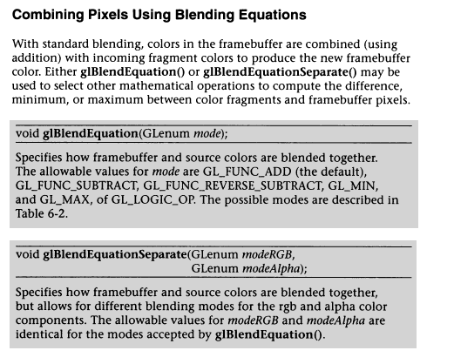

Slide 9
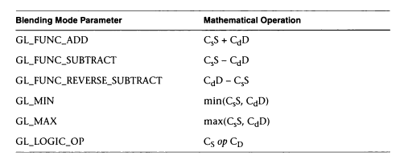

Slide 10
#include <stdlib.h>
#include <glut.h>
static int leftFirst = GL_TRUE;
static void init(void) /* Initialize alpha blending function. */
{
glEnable (GL_BLEND);
glBlendFunc (GL_SRC_ALPHA, GL_ONE_MINUS_SRC_ALPHA);
glShadeModel (GL_FLAT);
glClearColor (0.0, 0.0, 0.0, 0.0);
}
static void drawLeftTriangle(void)
{
glBegin (GL_TRIANGLES); /* draw yellow triangle on LHS of screen */
glColor4f(1.0, 1.0, 0.0, 0.75);
glVertex3f(0.1, 0.9, 0.0);
glVertex3f(0.1, 0.1, 0.0);
glVertex3f(0.7, 0.5, 0.0);
glEnd();
}

Slide 11
static void drawRightTriangle(void)
{
glBegin (GL_TRIANGLES); /* draw cyan triangle on RHS of screen */
glColor4f(0.0, 1.0, 1.0, 0.75);
glVertex3f(0.9, 0.9, 0.0); glVertex3f(0.3, 0.5, 0.0); glVertex3f(0.9, 0.1, 0.0); glEnd();
}
void display(void)
{
glClear(GL_COLOR_BUFFER_BIT);
if (leftFirst) {
drawLeftTriangle();
drawRightTriangle();
}
else {
drawRightTriangle();
drawLeftTriangle();
}
glFlush();
}
void reshape(int w, int h)
{
glViewport(0, 0, (GLsizei) w, (GLsizei) h);
glMatrixMode(GL_PROJECTION);
glLoadIdentity();
if (w <= h)
gluOrtho2D (0.0, 1.0, 0.0, 1.0*(GLfloat)h/(GLfloat)w);
else
gluOrtho2D (0.0, 1.0*(GLfloat)w/(GLfloat)h, 0.0, 1.0);
}

Slide 12
void keyboard(unsigned char key, int x, int y)
{
switch (key) {
case 't':
case 'T':
leftFirst = !leftFirst;
glutPostRedisplay();
break;
case 27: /* Escape key */
exit(0);
break;
default:
break;
}
}
int main(int argc, char** argv)
{
glutInit(&argc, argv);
glutInitDisplayMode (GLUT_SINGLE | GLUT_RGB);
glutInitWindowSize (200, 200);
glutCreateWindow (argv[0]);
init();
glutReshapeFunc (reshape);
glutKeyboardFunc (keyboard);
glutDisplayFunc (display);
glutMainLoop();
return 0;
}

Slide 13


Slide 14
#include <stdlib.h>
#include <stdio.h>
#include <glut.h>
#define MAXZ 8.0 #define MINZ -8.0 #define ZINC 0.4
static float solidZ = MAXZ; static float transparentZ = MINZ;
static GLuint sphereList, cubeList;
static void init(void)
{
GLfloat mat_specular[] = { 1.0, 1.0, 1.0, 0.15 };
GLfloat mat_shininess[] = { 100.0 };
GLfloat position[] = { 0.5, 0.5, 1.0, 0.0 };
glMaterialfv(GL_FRONT, GL_SPECULAR, mat_specular);
glMaterialfv(GL_FRONT, GL_SHININESS, mat_shininess);
glLightfv(GL_LIGHT0, GL_POSITION, position);
glEnable(GL_LIGHTING);
glEnable(GL_LIGHT0);
glEnable(GL_DEPTH_TEST);
sphereList = glGenLists(1);
glNewList(sphereList, GL_COMPILE);
glutSolidSphere (0.4, 16, 16);
glEndList();
cubeList = glGenLists(1);
glNewList(cubeList, GL_COMPILE);
glutSolidCube (0.6);
glEndList();
}

Slide 15
void display(void)
{
GLfloat mat_solid[] = { 0.75, 0.75, 0.0, 1.0 };
GLfloat mat_zero[] = { 0.0, 0.0, 0.0, 1.0 };
GLfloat mat_transparent[] = { 0.0, 0.8, 0.8, 0.6 };
GLfloat mat_emission[] = { 0.0, 0.3, 0.3, 0.6 };
glClear (GL_COLOR_BUFFER_BIT | GL_DEPTH_BUFFER_BIT);
glPushMatrix ();
glTranslatef (-0.15, -0.15, solidZ);
glMaterialfv(GL_FRONT, GL_EMISSION, mat_zero);
glMaterialfv(GL_FRONT, GL_DIFFUSE, mat_solid);
glCallList (sphereList);
glPopMatrix ();
glPushMatrix ();
glTranslatef (0.15, 0.15, transparentZ);
glRotatef (15.0, 1.0, 1.0, 0.0);
glRotatef (30.0, 0.0, 1.0, 0.0);
glMaterialfv(GL_FRONT, GL_EMISSION, mat_emission);
glMaterialfv(GL_FRONT, GL_DIFFUSE, mat_transparent);

Slide 16
glEnable (GL_BLEND);
glDepthMask (GL_FALSE);
glBlendFunc (GL_SRC_ALPHA, GL_ONE);
glCallList (cubeList);
glDepthMask (GL_TRUE);
glDisable (GL_BLEND);
glPopMatrix ();
glutSwapBuffers(); }

Slide 17
void reshape(int w, int h)
{
glViewport(0, 0, (GLint) w, (GLint) h);
glMatrixMode(GL_PROJECTION);
glLoadIdentity();
if (w <= h)
glOrtho (-1.5, 1.5, -1.5*(GLfloat)h/(GLfloat)w,
1.5*(GLfloat)h/(GLfloat)w, -10.0, 10.0);
else
glOrtho (-1.5*(GLfloat)w/(GLfloat)h,
1.5*(GLfloat)w/(GLfloat)h, -1.5, 1.5, -10.0, 10.0);
glMatrixMode(GL_MODELVIEW);
glLoadIdentity();
}
void animate(void)
{
if (solidZ <= MINZ || transparentZ >= MAXZ)
glutIdleFunc(NULL);
else {
solidZ -= ZINC;
transparentZ += ZINC;
glutPostRedisplay();
}
}

Slide 18
void keyboard(unsigned char key, int x, int y)
{
switch (key) {
case 'a':
case 'A':
solidZ = MAXZ;
transparentZ = MINZ;
glutIdleFunc(animate);
break;
case 'r':
case 'R':
solidZ = MAXZ;
transparentZ = MINZ;
glutPostRedisplay();
break;
case 27:
exit(0);
}
}
int main(int argc, char** argv)
{
glutInit(&argc, argv);
glutInitDisplayMode (GLUT_SINGLE | GLUT_RGB | GLUT_DEPTH);
glutInitWindowSize(500, 500);
glutCreateWindow(argv[0]);
init();
glutReshapeFunc(reshape);
glutKeyboardFunc(keyboard);
glutDisplayFunc(display);
glutMainLoop();
return 0;
}

Slide 20
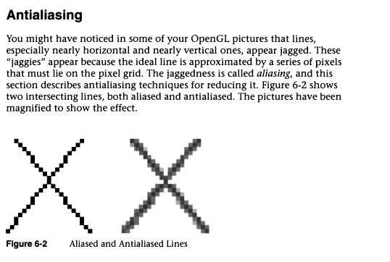

Slide 21
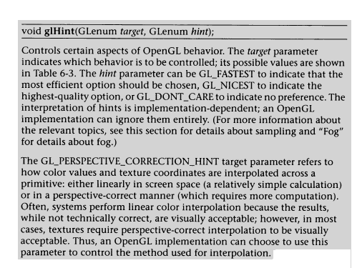

Slide 22
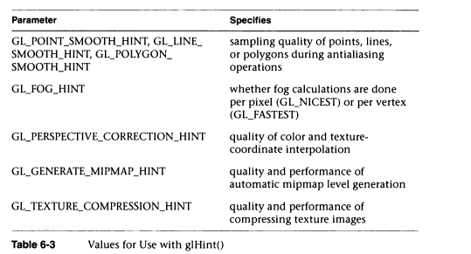

Slide 23
#include <stdlib.h>
#include <stdio.h>
#include <glut.h>
static float rotAngle = 0.;
void init(void)
{
glEnable (GL_LINE_SMOOTH);
glEnable (GL_BLEND);
glBlendFunc (GL_SRC_ALPHA, GL_ONE_MINUS_SRC_ALPHA);
glHint (GL_LINE_SMOOTH_HINT, GL_DONT_CARE);
glLineWidth (1.5);
glClearColor(0.0, 0.0, 0.0, 0.0);
}

Slide 24
void display(void)
{
glClear(GL_COLOR_BUFFER_BIT);
glColor3f (0.0, 1.0, 0.0);
glPushMatrix();
glRotatef(-rotAngle, 0.0, 0.0, 0.1);
glBegin (GL_LINES);
glVertex2f (-0.5, 0.5);
glVertex2f (0.5, -0.5);
glEnd ();
glPopMatrix();
glColor3f (0.0, 0.0, 1.0);
glPushMatrix();
glRotatef(rotAngle, 0.0, 0.0, 0.1);
glBegin (GL_LINES);
glVertex2f (0.5, 0.5);
glVertex2f (-0.5, -0.5);
glEnd ();
glPopMatrix();
glFlush();
}

Slide 25
void reshape(int w, int h)
{
glViewport(0, 0, w, h);
glMatrixMode(GL_PROJECTION);
glLoadIdentity();
if (w <= h)
gluOrtho2D (-1.0, 1.0,
-1.0*(GLfloat)h/(GLfloat)w, 1.0*(GLfloat)h/(GLfloat)w);
else
gluOrtho2D (-1.0*(GLfloat)w/(GLfloat)h,
1.0*(GLfloat)w/(GLfloat)h, -1.0, 1.0);
glMatrixMode(GL_MODELVIEW);
glLoadIdentity();
}
void keyboard(unsigned char key, int x, int y)
{
switch (key) {
case 'r':
case 'R':
rotAngle += 20.;
if (rotAngle >= 360.) rotAngle = 0.;
glutPostRedisplay();
break;
case 27: /* Escape Key */
exit(0);
break;
default:
break;
}
}

Slide 26
int main(int argc, char** argv)
{
glutInit(&argc, argv);
glutInitDisplayMode (GLUT_SINGLE | GLUT_RGB);
glutInitWindowSize (200, 200);
glutCreateWindow (argv[0]);
init();
glutReshapeFunc (reshape);
glutKeyboardFunc (keyboard);
glutDisplayFunc (display);
glutMainLoop();
return 0;
}

Slide 28
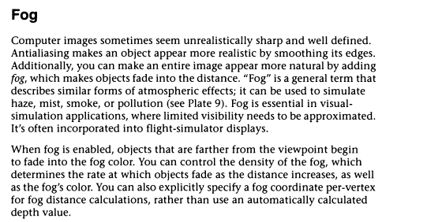

Slide 29
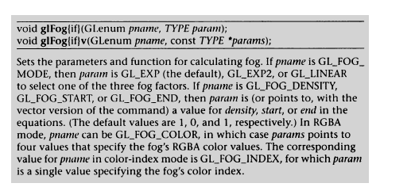
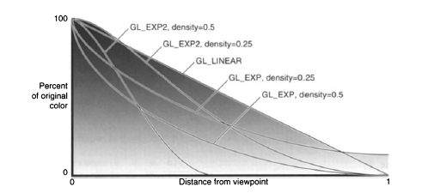

Slide 30
#include <stdlib.h>
#include <stdio.h>
#include <math.h>
#include <glut.h>
static GLint fogMode;
static void init(void)
{
GLfloat position[] = { 0.5, 0.5, 3.0, 0.0 };
glEnable(GL_DEPTH_TEST);
glLightfv(GL_LIGHT0, GL_POSITION, position);
glEnable(GL_LIGHTING);
glEnable(GL_LIGHT0);
{
GLfloat mat[3] = {0.1745, 0.01175, 0.01175};
glMaterialfv (GL_FRONT, GL_AMBIENT, mat);
mat[0] = 0.61424; mat[1] = 0.04136; mat[2] = 0.04136;
glMaterialfv (GL_FRONT, GL_DIFFUSE, mat);
mat[0] = 0.727811; mat[1] = 0.626959; mat[2] = 0.626959;
glMaterialfv (GL_FRONT, GL_SPECULAR, mat);
glMaterialf (GL_FRONT, GL_SHININESS, 0.6*128.0);
}

Slide 31
glEnable(GL_FOG);
{
GLfloat fogColor[4] = {0.5, 0.5, 0.5, 1.0};
fogMode = GL_EXP;
glFogi (GL_FOG_MODE, fogMode);
glFogfv (GL_FOG_COLOR, fogColor);
glFogf (GL_FOG_DENSITY, 0.35);
glHint (GL_FOG_HINT, GL_DONT_CARE);
glFogf (GL_FOG_START, 1.0);
glFogf (GL_FOG_END, 5.0);
}
glClearColor(0.5, 0.5, 0.5, 1.0); /* fog color */
}

Slide 32
static void renderSphere (GLfloat x, GLfloat y, GLfloat z)
{
glPushMatrix();
glTranslatef (x, y, z);
glutSolidSphere(0.4, 16, 16);
glPopMatrix();
}
void display(void)
{
glClear(GL_COLOR_BUFFER_BIT | GL_DEPTH_BUFFER_BIT);
renderSphere (-2., -0.5, -1.0);
renderSphere (-1., -0.5, -2.0);
renderSphere (0., -0.5, -3.0);
renderSphere (1., -0.5, -4.0);
renderSphere (2., -0.5, -5.0);
glFlush();
}
void reshape(int w, int h)
{
glViewport(0, 0, (GLsizei) w, (GLsizei) h);
glMatrixMode(GL_PROJECTION);
glLoadIdentity();
if (w <= h)
glOrtho (-2.5, 2.5, -2.5*(GLfloat)h/(GLfloat)w,
2.5*(GLfloat)h/(GLfloat)w, -10.0, 10.0);
else
glOrtho (-2.5*(GLfloat)w/(GLfloat)h,
2.5*(GLfloat)w/(GLfloat)h, -2.5, 2.5, -10.0, 10.0);
glMatrixMode(GL_MODELVIEW);
glLoadIdentity ();
}

Slide 33
void keyboard(unsigned char key, int x, int y)
{
switch (key) {
case 'f':
case 'F':
if (fogMode == GL_EXP) {
fogMode = GL_EXP2;
printf ("Fog mode is GL_EXP2\n");
}
else if (fogMode == GL_EXP2) {
fogMode = GL_LINEAR;
printf ("Fog mode is GL_LINEAR\n");
}
else if (fogMode == GL_LINEAR) {
fogMode = GL_EXP;
printf ("Fog mode is GL_EXP\n");
}
glFogi (GL_FOG_MODE, fogMode);
glutPostRedisplay();
break;
case 27:
exit(0);
break;
default:
break;
}
}
int main(int argc, char** argv)
{
glutInit(&argc, argv);
glutInitDisplayMode (GLUT_SINGLE | GLUT_RGB | GLUT_DEPTH);
glutInitWindowSize(500, 500);
glutCreateWindow(argv[0]);
init();
glutReshapeFunc (reshape);
glutKeyboardFunc (keyboard);
glutDisplayFunc (display);
glutMainLoop();
return 0;
}

Slide 34
fog
#include <stdlib.h>
#include <glut.h>
#include <math.h>
GLfloat angle = 0.0;
GLfloat density = 0.5; //set the density to 0.3 which is acctually quite thick
GLfloat fogColor[4] = { 0.5, 0.5, 0.5, 1.0 }; //set the for color to grey
void cube(void) {
glRotatef(angle, 1.0, 0.0, 0.0);
glRotatef(angle, 0.0, 1.0, 0.0);
glRotatef(angle, 0.0, 0.0, 1.0);
glColor3f(1.0, 0.0, 0.0);
glutSolidCube(2);
}

Slide 35
void init(void) {
glEnable(GL_DEPTH_TEST); //enable the depth testing
glEnable(GL_FOG); //enable the fog
glFogi(GL_FOG_MODE, GL_EXP2); //set the fog mode to GL_EXP2
glFogfv(GL_FOG_COLOR, fogColor); //set the fog color toour color chosen above
glFogf(GL_FOG_DENSITY, density); //set the density to thevalue above
glHint(GL_FOG_HINT, GL_NICEST); // set the fog to look thenicest
}
void display(void) {
glClearColor(0.0, 0.0, 0.0, 1.0);
glClear(GL_COLOR_BUFFER_BIT | GL_DEPTH_BUFFER_BIT);
glLoadIdentity();
gluLookAt(0.0, 0.0, 5.0, 0.0, 0.0, 0.0, 0.0, 1.0, 0.0);
cube();
glutSwapBuffers();
angle=angle+0.01;}

Slide 36
void reshape(int w, int h) {
glViewport(0, 0, (GLsizei)w, (GLsizei)h);
glMatrixMode(GL_PROJECTION);
glLoadIdentity();
gluPerspective(60, (GLfloat)w / (GLfloat)h, 1.0, 100.0);
glMatrixMode(GL_MODELVIEW);
}
int main(int argc, char **argv) {
glutInit(&argc, argv);
glutInitDisplayMode(GLUT_DOUBLE | GLUT_RGBA | GLUT_DEPTH
);
glutInitWindowSize(500, 500);
glutInitWindowPosition(100, 100);
glutCreateWindow("A basic OpenGL Window");
init();
glutDisplayFunc(display);
glutIdleFunc(display);
glutReshapeFunc(reshape);
glutMainLoop();
return 0;}

